Slide 1

Human Resource Management
ADVENTURE WORK COMPANY
HR DEPARTMENT PRESENTATION

Slide 2
Human Resources Department Overview
Our Eighth Year
This year...
290
$108M
17
16
6
36
Total Sales
Average Age
Total No. Employees
Total Sales - Person
Total Departments
Total Department Group

Slide 3
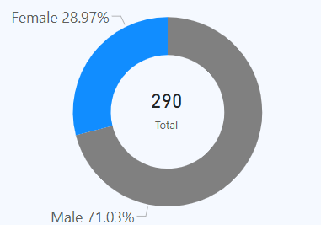
Assessing Gender Representation: Male-Dominated Workforce By 71%.
Gender Distribution

Slide 4
What are importance of gender diversity in modern workplaces?
Enhanced Creativity and Innovation: 60% of companies with a gender-diverse workforce report increased profits and productivity
Improved Decision-Making: Diverse teams make better decisions 87% of the time compared to non-diverse teams
Attraction and Retention of Talent: Companies that embrace gender diversity access a wider talent pool, with a McKinsey report showing that diverse teams are 35% more likely to outperform their industry's median financial returns.
Enhanced Financial Performance: Companies with gender-diverse teams are 21% more likely to outperform on profitability.
Strengthened Company Reputation: Gender diversity boosts a company’s image, showing it values equality and inclusivity, which appeals to customers and clients.

Slide 5
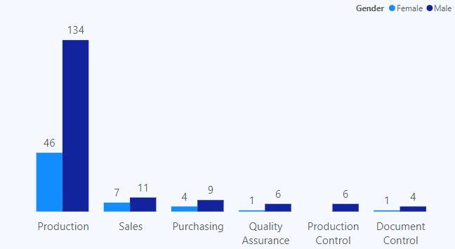
Gender Imbalance in Key Departments: Targeted Female Recruitment Strategy.
Departmental Gender Distribution: Female vs. Male Workforce

Slide 6
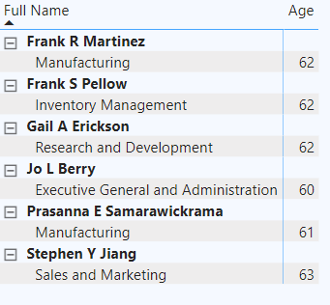
Retirement-Eligible Employees: Strategic Hiring and Diversity Focus.
Retirement-Eligible Employees Age (60+) By Departmental Overview

Slide 7
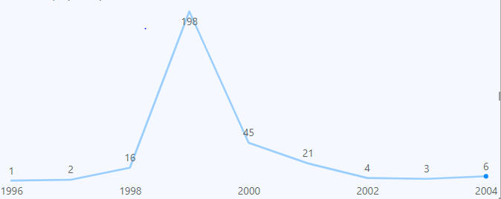
Projected Retirements in Q3 2004: Preparing for Workforce Transitions.
Next Quarter Employee Hiring Trends

Slide 8
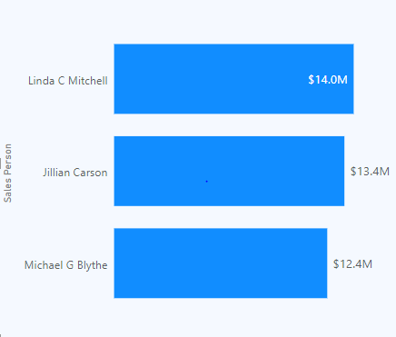
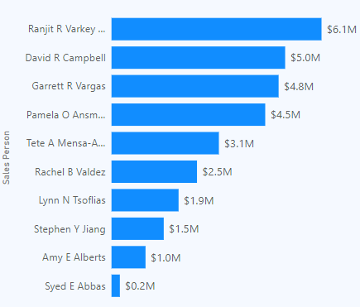
Highlighting Excellence: Top 3 vs. Bottom 10 Sales Contributors.
Top 3 Salesperson By Revenue Contribution
Bottom 10 salespeople By Revenue Contribution

Slide 9
Actions HR Department and Individuals Can Take.
Recommendation
The company aims for a 20% increase in female manufacturing roles by Q4 2005 through specialized training and technology, with progress reviewed by Q4 2005.
Gender Diversity
HR should implement succession planning and a recruitment strategy to address upcoming retirements, ensuring all vacancies are filled by the end of Q3 2004 to maintain smooth operations and prevent leadership gaps.
Succession Planning for Retiring Employees
  Underperforming salespeople should receive mentorship and training to improve by 15% over two quarters, while a reward system for the top 3 performers will boost motivation and support revenue goals.
Sales Performance Improvement

Slide 10

Thanks!
Do you have any questions?
Dkemboi888@Gmail.com
+254 724 006 132

